Slide 1

Developing A Network Design For A Smart Airport Using A Cisco Packet Tracer
19CCE304 - Computer Networks
Fifth Semester
B. Tech., Computer and Communication Engineering (CCE)

Slide 2
CCE Team 9
Name | Roll Number
B Ambareesh | CB.EN.U4CCE20006
Narendran S | CB.EN.U4CCE20036
Narun T | CB.EN.U4CCE20037
Pabbathi Greeshma | CB.EN.U4CCE20040
Santosh | CB.EN.U4CCE20053

Slide 3
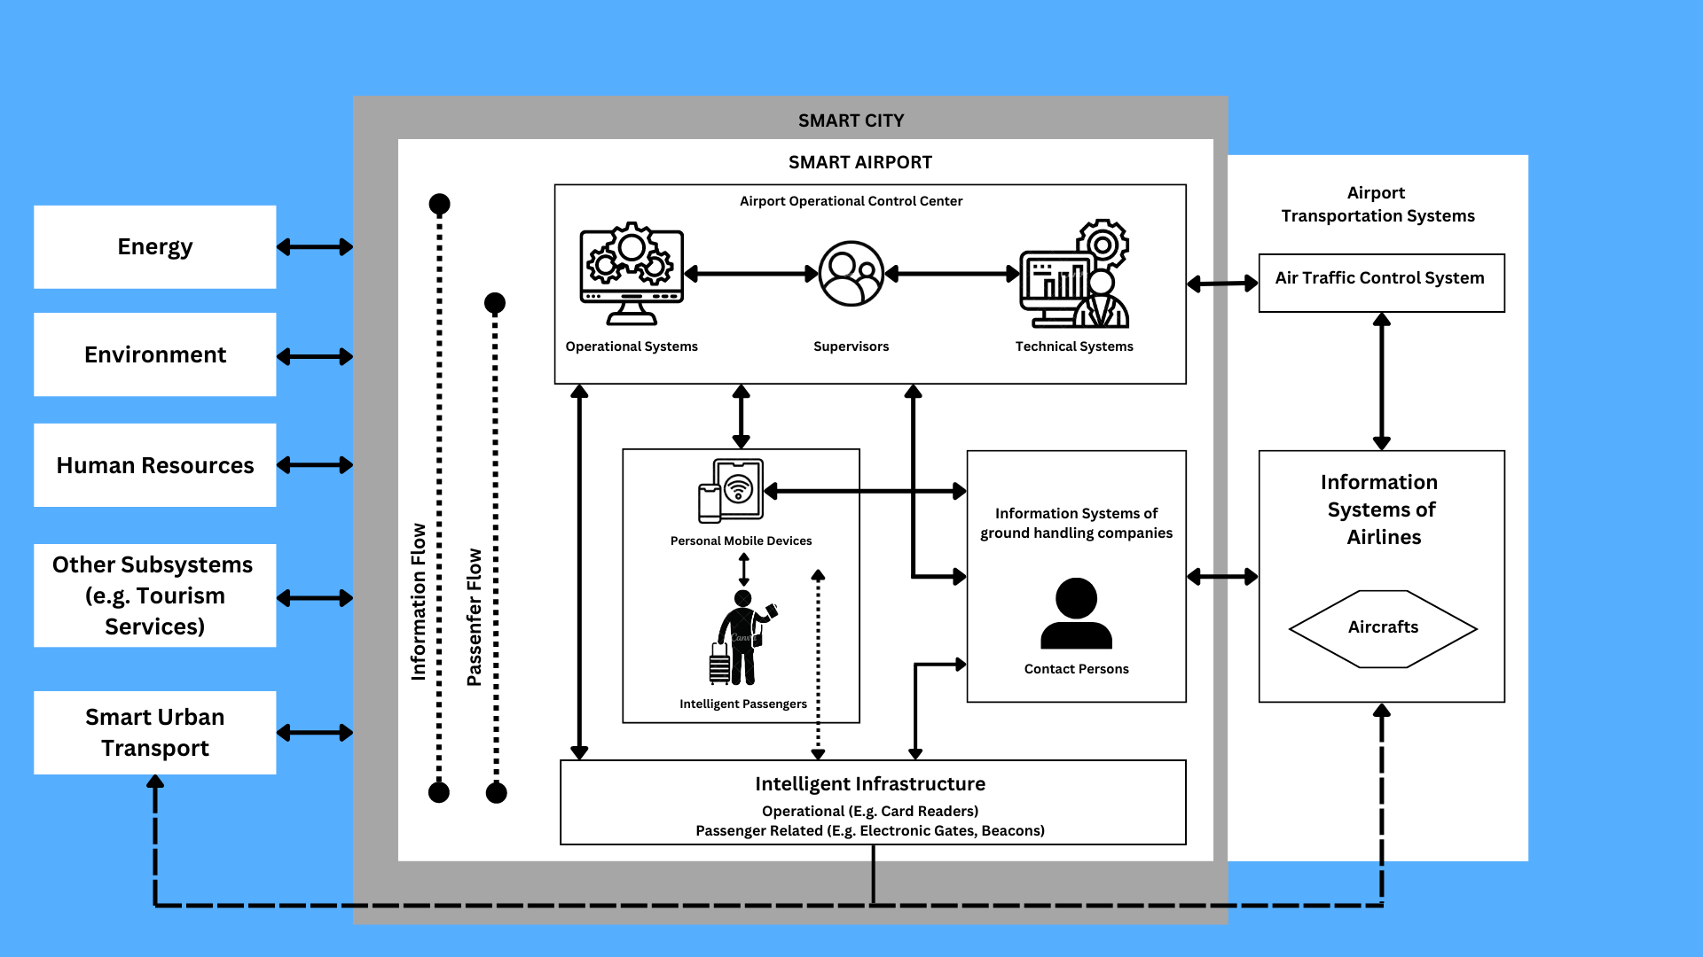
Abstract
The fast-changing world is evolving towards automation rapidly every day, and a good network system is inevitable anywhere to properly manage an automated system.
Before implementing a network system, it is necessary to visualize and learn a protocol to understand the system in depth and identify its issues.
Packet Tracer is a cross-platform visual simulation tool designed by Cisco Systems that allows users to create network topologies and imitate modern computer networks.
It helps network developers design prototype models and provides a virtual network simulation platform that helps simulate projects and observe their efficiency in the real world.
In this research, the authors have developed a prototype of the network design of an airport using a Cisco Packet Tracer.
The process that depicts how the network system will work in real life is explained and the simulation of data transmission is provided.

Slide 4

Objectives
Gather knowledge about computer networks.
Learn about Cisco Packet Tracer in depth.
Get experience in how real-life projects work.
Learn about networking systems and network design.
Develop a prototype of network design, suitable for an airport.

Slide 5
Methodology
1. Air Control Room – Static Routing
2. Arrival/Departure Room
Employee Department – Default Gateway IP
3. Security Room
Guest Department – Mask Subnet
Internet of Things (IoT) Device – Live Feedback
Server Room – Basic Servers to Collect & Store Data

Slide 6
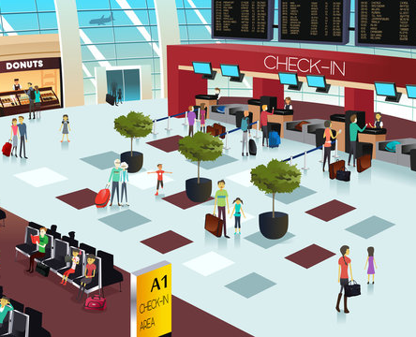

Results & Analysis
Air Quality Check
Lounge for Staff Only (Employee Department)
Lounge for Travelers Only (Guest Department)
Smart Garden
Boarding Area
Highly Restricted Area
Secured Airport Communications
Air Control Room - Network Address Translation (NAT)

Slide 7
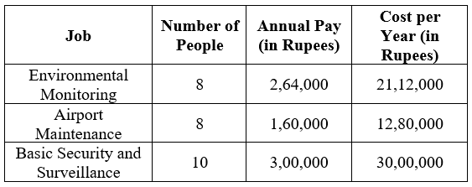
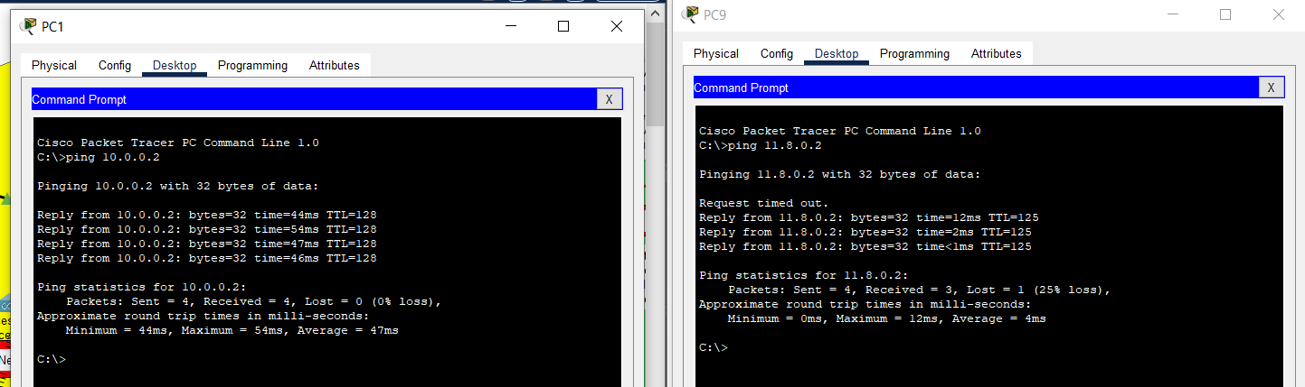
Novelty & Contributions Made
Exploring The Security Challenge
From Chaos to New Order
Applying Existing Technology in a New Way
Integrated Solutions
Unifying Video Surveillance
Integrating Security Voice, Video and Data Systems

Slide 8
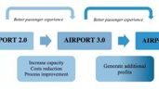
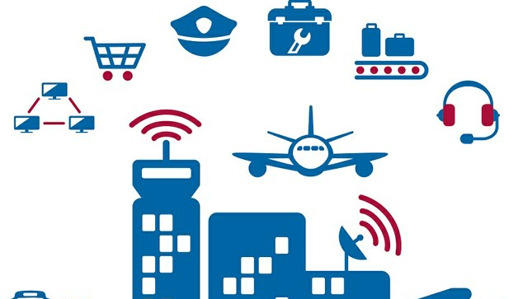
Conclusions
In this work, a prototype of network design for an airport has been successfully developed and tested in the real-time simulation mode available in Cisco Packet Tracer.
This prototype has been developed in such a way that ensures faster data transmission and secured network connections.
In addition, this network design makes sure that any unwanted data transmission cannot happen.
All these implementations help to develop smooth network connections as well as make the network design secure enough to operate.
We have ensured successful connectivity among all the devices in this network system.

Slide 9
References
Serial Number | Base Paper | Cisco Documentations | Journals & Conference Papers | Packet Tracer YouTube Tutorials
 |  |  |  | Video Name | URL
1 | Ahmed Imran KABIR & Sriman MITRA & Suraya AKTER & Md Rakibul ISLAM & Soumya Suhreed DAS, 2022. "Developing a Network Design for a Smart Airport Using Cisco Packet Tracer," Informatica Economica, Academy of Economic Studies - Bucharest, Romania, vol. 26(1), pages 25-38. | Airport Network Integration Eases Costs, Improves Security, And Enhances Operations, Cisco Systems, Inc. | N. Koroniotis, N. Moustafa, F. Schiliro, P. Gauravaram and H. Janicke, "A Holistic Review of Cybersecurity and Reliability Perspectives in Smart Airports," in IEEE Access, vol. 8, pp. 209802-209834, 2020, DOI: 10.1109/ACCESS.2020.3036728. | Air Quality Check (or) Environment Monitoring System using Packet Tracer | IoT Application | https://www.youtube.com/watch?v=4ht5FojLI7I&t=449s&ab_channel=TechnoBrunch
2 |  | Cisco Intelligent Airport Wireless (Wi-Fi) Network Solution, White Paper, Cisco Systems, Inc. | Rajapaksha, Aruna & Jayasuriya, Nisha. (2020). Smart Airport: A Review on Future of the Airport Operation. Global Journal of Management and Business Research. 20. 10.34257/GJMBRAVOL20IS3PG25. | Cisco Packet Tracer - RFID, Bluetooth, Smartphone | https://www.youtube.com/watch?v=cPewlj0kEtk&t=340s&ab_channel=DrSKhan
3 |  | Cisco Technology Helps Keep Passengers, Plans, and Luggage on Schedule at Sydney Airport, Business Case, Cisco Systems, Inc. | Alghadeir, Abdullah and Sakran, Hasan Al-, Smart Airport Architecture Using Internet of Things (September 30, 2016). International Journal of Innovative Research in Computer Science & Technology (IJIRCST) ISSN: 2347-5552, Volume-4, Issue-5, September 2016. | Configuration of Wireless Heterogeneous Network using Cisco Packet Tracer | https://www.youtube.com/watch?v=UZwB7JTgYCc&ab_channel=Dr.ShubhangiKharche
4 |  |  |  | How to Configure a Smart Home Design in Cisco Packet Tracer | IoT Devices Configure | End Devices | https://www.youtube.com/watch?v=vjPWanGskek&ab_channel=ProgrammingFrog
5 |  |  |  | IoT Device Programming using Packet Tracer with Sensors and Actuators | https://www.youtube.com/watch?v=RH1az9-GxoY&t=698s&ab_channel=KayalvizhiJayavel
6 |  |  |  | Smart Garden in Packet Tracer | https://www.youtube.com/watch?v=DdeXrsMFnq4&t=7s&ab_channel=HaiderTech
7 |  |  |  | Smart Security System using Packet Tracer | IoT application | Anti-Theft System using Packet Tracer | https://www.youtube.com/watch?v=42DCkx36Uv8&ab_channel=TechnoBrunch
8 |  |  |  | Static NAT Configuration in Cisco Packet Tracer 2019 | https://www.youtube.com/watch?v=pErjl9WA1V8&t=919s&ab_channel=KrishnoDey

